Slide 1
Whats the intent with activites?
Android stuffs

Slide 2

Android
Notes:
Linux based (kernel)
Own UI toolkit, shares some parts of the framwork api with suns jre
SDK Free (Win, Mac, Linux), device debugging free, Market account $25

Slide 3

AOSP
Notes:
’Open Source’ (AOSP, Android Open Source Project)
Core functionality, telephone, sms, email, contacts. No google apps
Google apps (market, gmail etc) requires contract with google

Slide 4

Dalvik
Notes:
Open Source java virtual machine designed for ’compact systems’
http://en.wikipedia.org/wiki/Dalvik_(software)
Compatible with most java libraries

Slide 5

Eclipse
Notes:
Recommended plattform from google
http://developer.android.com/sdk/installing.html

Slide 6

IDEA
Notes:
Community edition free, by jetbrains
http://www.jetbrains.com/idea/free_java_ide.html
http://wiki.jetbrains.net/intellij/Developing_applications_for_Android_in_IntelliJ_IDEA

Slide 7

Native
Notes:
C,C++, Asm
Most things possible, designed for high performace opengl apps, codecs and other things

Slide 8

Activites
Notes:
Presentation layer, uses a view to define a layout
http://www.flickr.com/photos/stuckincustoms/3946279121/sizes/l/in/photostream/

Slide 9

Navigation between activites
Notes:
Stackbased
Startactivity/startactivityforresult to push, return, backkey to pop

Slide 10
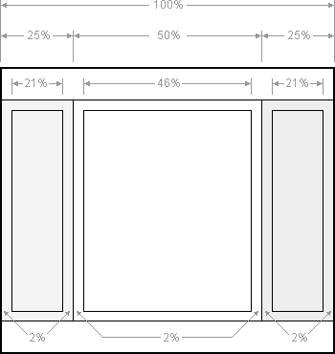
Layout
Notes:
Primarily Xml based but can be defined from code too

Slide 11
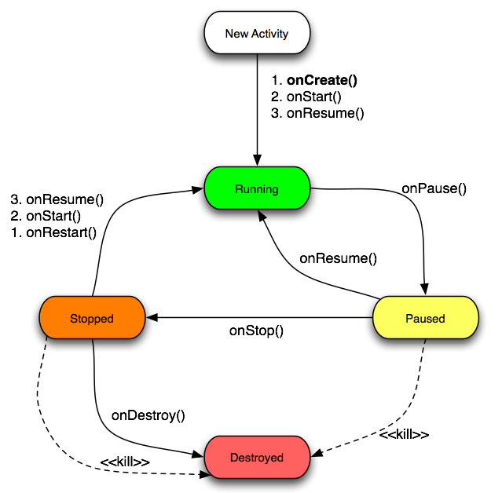
Activity lifecycle
Notes:
Priority: Visible (activity), services, background (activity w/o service)
Possible to save ui state

Slide 12

Intents
Notes:
Message passing within & between applications
Start activity/service to perform and action or broadcast event or start a activity/server
Startactivity / startactivityforresult for activites
Onactivityresult callback
http://www.flickr.com/photos/craftydame/4383720879/sizes/l/in/photostream/

Slide 13
Move within an application
new Intent(MainActivity.this, FooActivity.class);
Notes:
From MainActivity start the activity FooActivity

Slide 14
Taking a Picture
new Intent(MediaStore.ACTION_IMAGE_CAPTURE);
Notes:
Starts the camera application and should return the uri to a image if one has been captured

Slide 15
Barcode Scanner
new Intent("com.google.zxing.client.android.SCAN");
Notes:
http://code.google.com/p/zxing/
Scans QR codes, regular barcodes etc
Returns a scanned barcode

Slide 16

Service
Notes:
IntentService, (async) backend work
StartService with intent

Slide 17
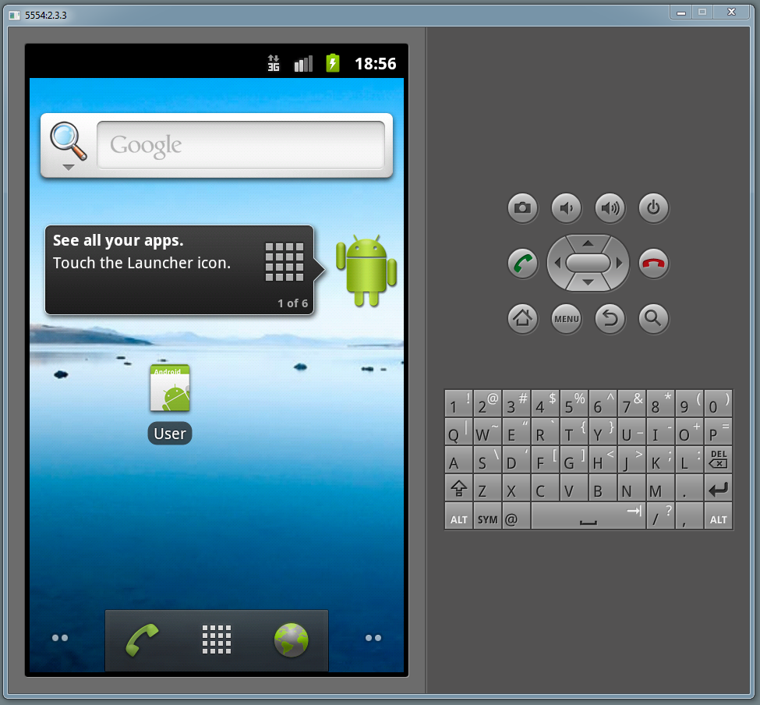
Example project

Slide 18

Concept
Notes:
Publisher exposes an activty that can only be reached by sending a specific intent
User app can call intent publisher exposes, unknown intent & intent to start the camera activity

Slide 19

Publisher
Notes:
2 activites
StartupActivity & PublisherActivity
PubliserActivity can only be reached by sending the DEMO intent

Slide 20

User
Notes:
One Activity
4 buttons, send intent that publisher responds to, take a picture, send an intent that crashes the app, and check if intent is published to avoid crashing

Slide 21

Questions?
Notes:
Example projects with repo

